Slide 1

Spy glass
developed by green machine

Slide 2

Why spy glass?
Ever had an itch for travel, didn’t know how to scratch it?
Spy glass is for the spontaneous and spur of the moment adventurer.
It offers the flexibility of looking up countries and gaining helpful insight to help start the foundation for your trip.
The green machine team is building an app that will help you discover the currency name, symbol, conversion rate, language spoken, capital city, and population of any country you wish!
that’s not all, our app converts currencies too!

Slide 3
User story
As a person interested in traveling
I want to be able to look up different countries, learn a little bit about them and my travel budget value in that country
So that I can plan a financially sound and enjoyable trip

Slide 4
Our acceptance criteria
Given I am using a budget travel guide
When I open the guide
Then the country code lookup is displayed
When Input country name or something close to it
Then the data waterfalls into the country code section and allows the user to scroll down to view possibilities
When I scroll down
Then I am presented with currency converter functions to, from, and amount
When I input the data
Then I am presented with the conversion amount

Slide 5
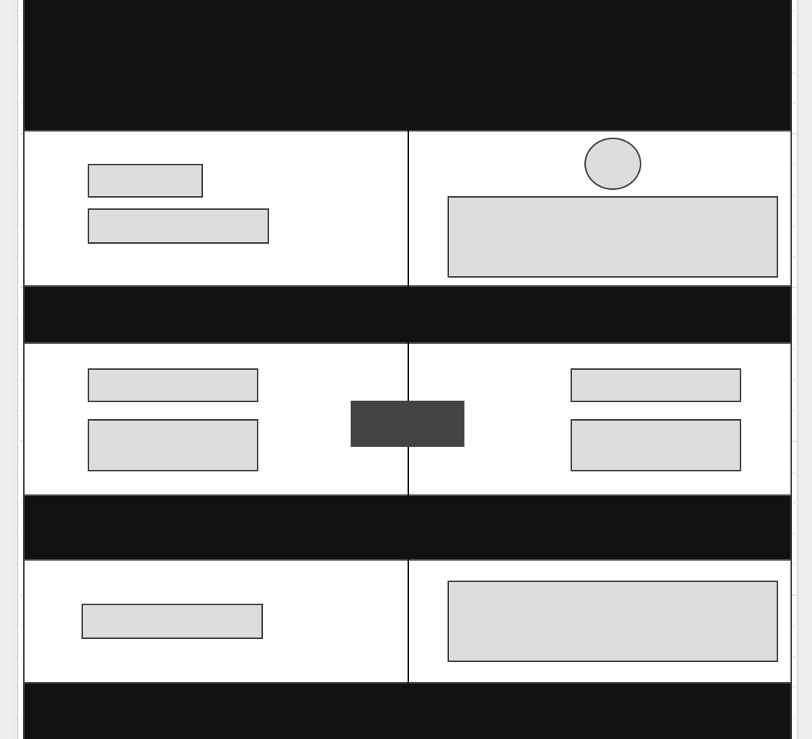
Wireframe

Slide 6


OUR FRONT END DEVELOPERS
Jacqueline Rodney, 24
Brooklyn, NY
Current Field: Education
Hopes to use the knowledge and skills from this course to move into tech through the beauty and fashion industry.
Illgner Alain Paul, 26
Long Island, NY
Current Field: Healthcare
Wants to be technologically independent and eventually use coding to create simple and positive changes in the world .

Slide 7


OUR Back END DEVELOPERS
Gabriel J. Sanchez, 26
Newark, NJ
Current Field:
Clinical Research
Hopes to develop coding skills to move into a field that he’s been interested in for a while
Greg Scott, 30
Brooklyn, NY
Current Field:
Educator
Originally from Dayton, Ohio, hoping to work on or develop applications that inspire creativity and connection between people

Slide 8
Our technology
JAVASCRIPT
JSON
SEMANTIC UI
API
REST COUNTRIES
CURRENCY CONVERTER

Slide 9
DEMO PRESENTED BY GREG SCOTT

Slide 10
EARLY CHALLENGES
API SELECTION AND INTEGRATION
GREAT IDEAS HAD TO BE COMPRESSED FOR EFFICIENCY
IDENTIFYING OUR STARTING POINT
COMFORTABILITY WITH MERGING ON GITHUB
STYLING AND PAGE LAYOUT
Notes:
Styling for example: drop down to select countries and currencies

Slide 11
WHAT TO EXPECT IN FUTURE DEVELOPMENTS
Conditional Information of countries
Swipe to Favorite Function
Country Code Suggestions
Input Budget and Save Total in Budget
Extend Search Parameters
Notes:
Conditional information such as food, major attractions, and other relevant info
Extend search parameters so that people can search based on experience rather than just country name
Country Code suggestions for the currency and location info portion

Slide 12
Thank you to our ta, Christian, and the rest of you watching

